Slide 1
6221 tutor
yyyy

Slide 2
Exam overview
Kinematics
Dynamics and Control
5 topics
Mobile Robots
Structure and Pose Estimation
Kalman Filter and Sensor Integration
Notes:
仅关注考试范围内的内容

Slide 3
1. kinematics

Slide 4
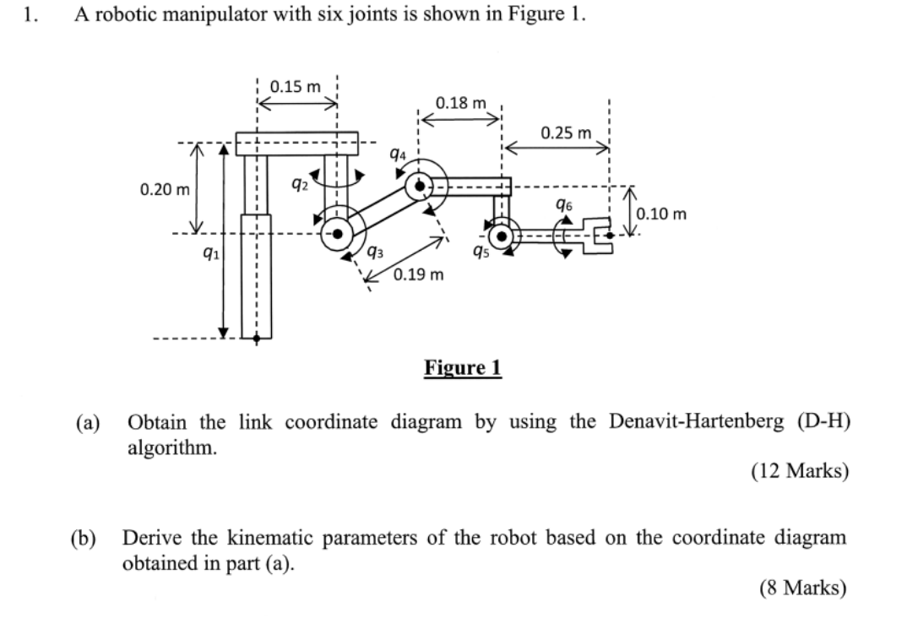
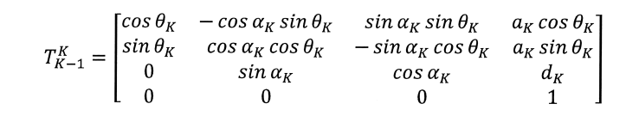
Kinematics
22-23 S2
Problem definition:
a) link diagram using D-H algorithm
b) Kinematics parameters
or b) transformation matrix
Notes:
Same problem in your quiz 1
Obtain the link coordinate diagram using dh algorithm
B: derive the kinematic parameters or transformation matrix

Slide 5
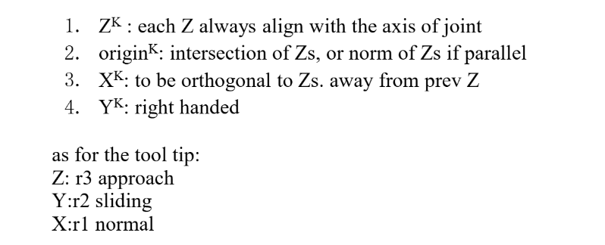
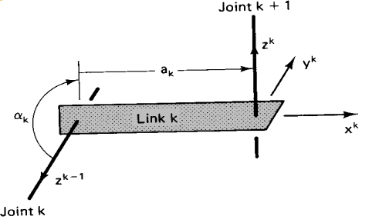
Kinematics – principle
The four parameters describe the transformation from the coordinate system k-1 attached to link k-1 to the coordinate system k attached to link k. The origin of coordinate system k-1 is $O_{k−1}$, and the coordinate axes are ($x_{k−1},y_{k−1},z_{k−1}$); the origin of coordinate system k is $O_{k}$, and the coordinate axes are $\left(x_{k},y_{k},z_{k}\right)$

Slide 6
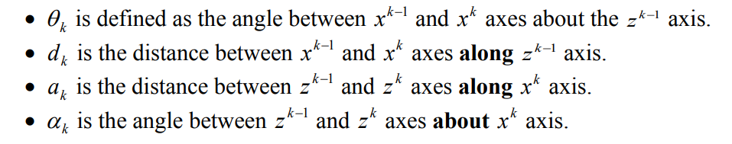
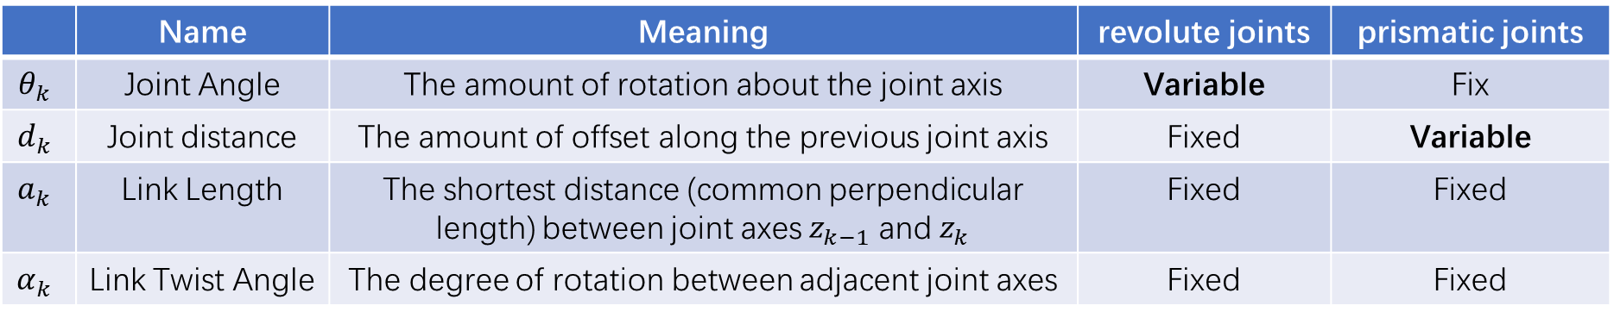
Kinematics – principle
 | Name | Meaning | revolute joints | prismatic joints
$$θ_{k}$$ | Joint Angle | The amount of rotation about the joint axis | Variable | Fix
$$d_{k}$$ | Joint distance | The amount of offset along the previous joint axis | Fixed | Variable
$$a_{k}$$ | Link Length | The shortest distance (common perpendicular length) between joint axes$z_{k−1}$and $z_{k}$ | Fixed | Fixed
$$α_{k}$$ | Link Twist Angle | The degree of rotation between adjacent joint axes | Fixed | Fixed

Slide 7
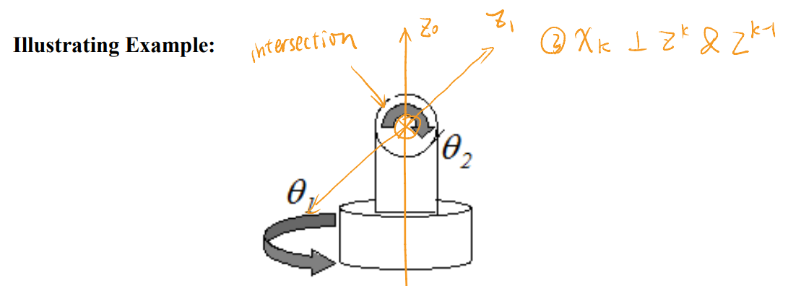
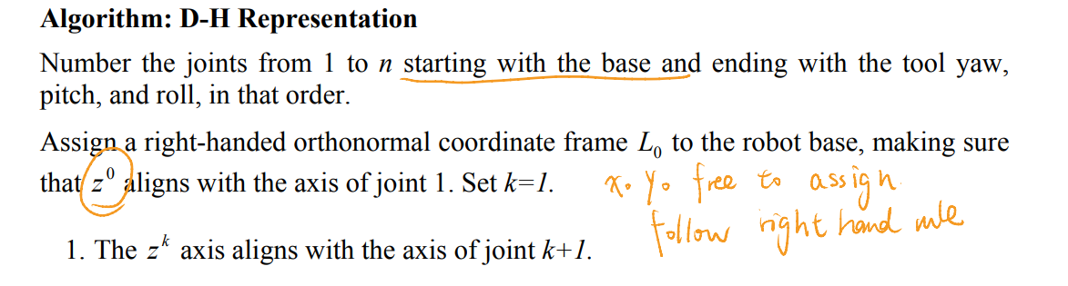
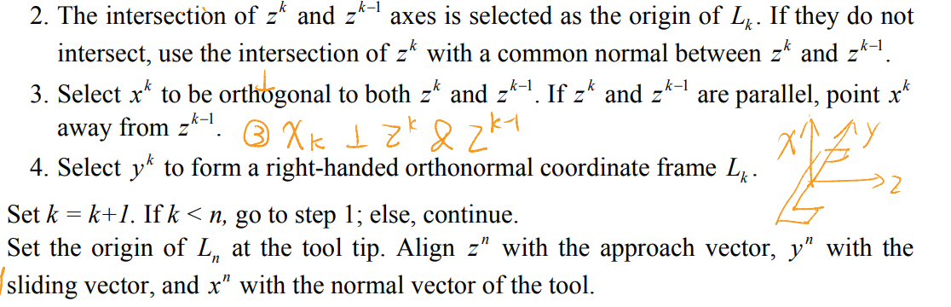
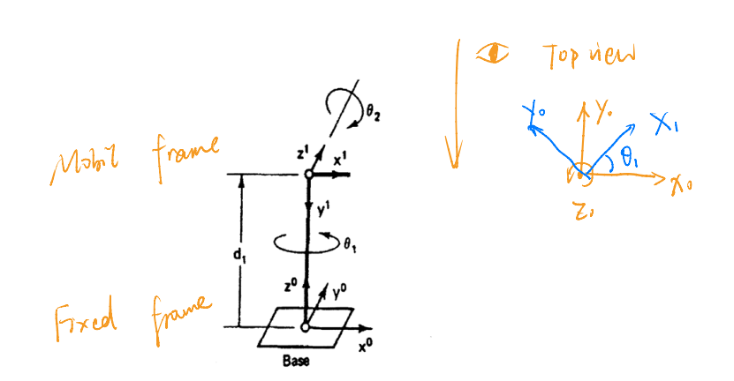
Kinematics – principle

Slide 8
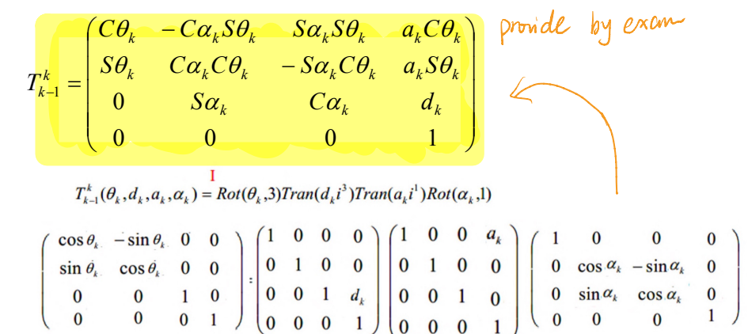
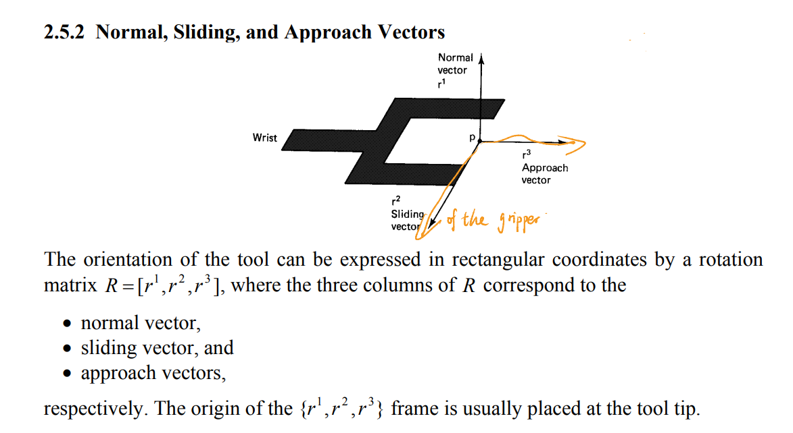
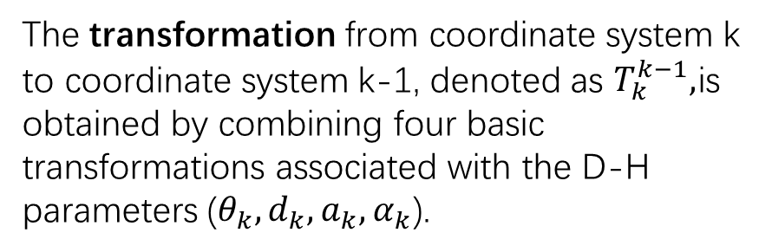
Kinematics – principle
Tool tips
The transformation from coordinate system k to coordinate system k-1, denoted as $T_{k}^{k−1},$is obtained by combining four basic transformations associated with the D-H parameters ($θ_{k},d_{k},a_{k},α_{k}$).

Slide 9
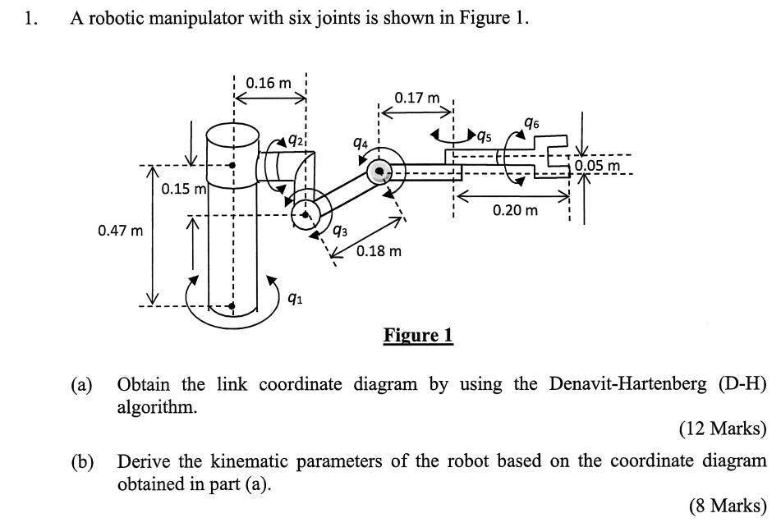
Kinematics – practise1
23-24 S2 Q1

Slide 10
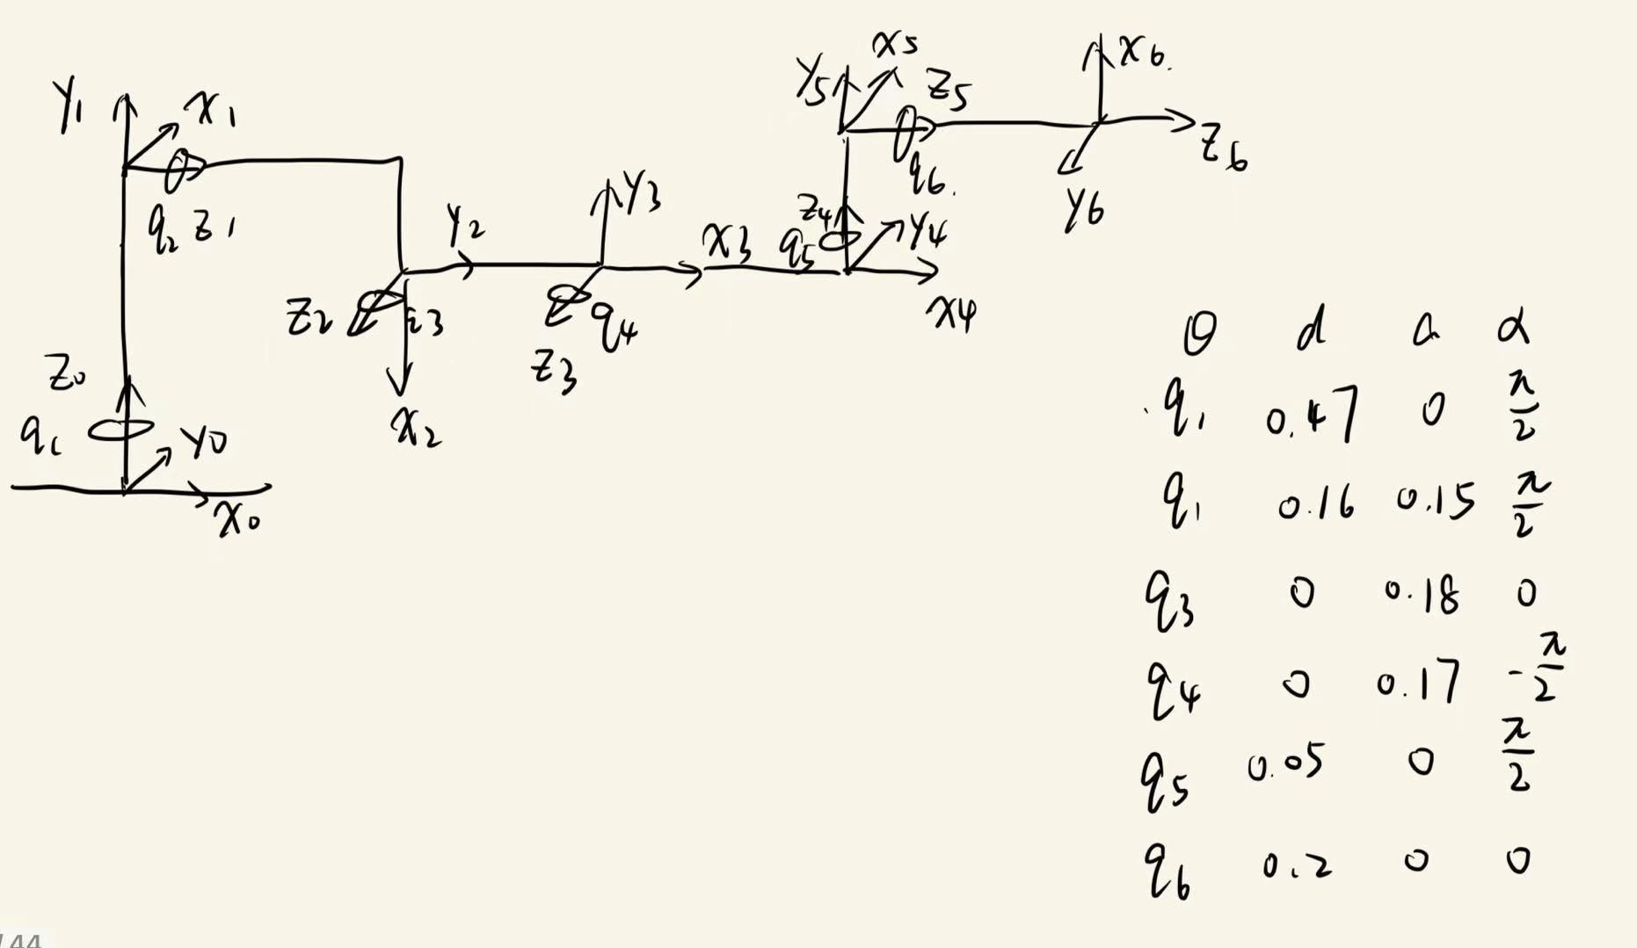
Kinematics – practise1

Slide 11
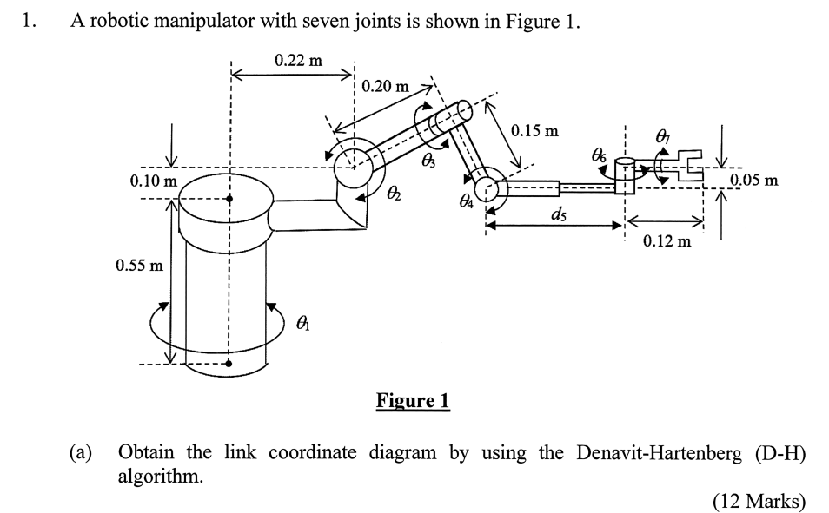
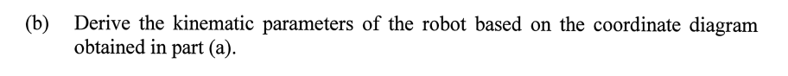
Kinematics – practise2
22-23 S2 Q1

Slide 12
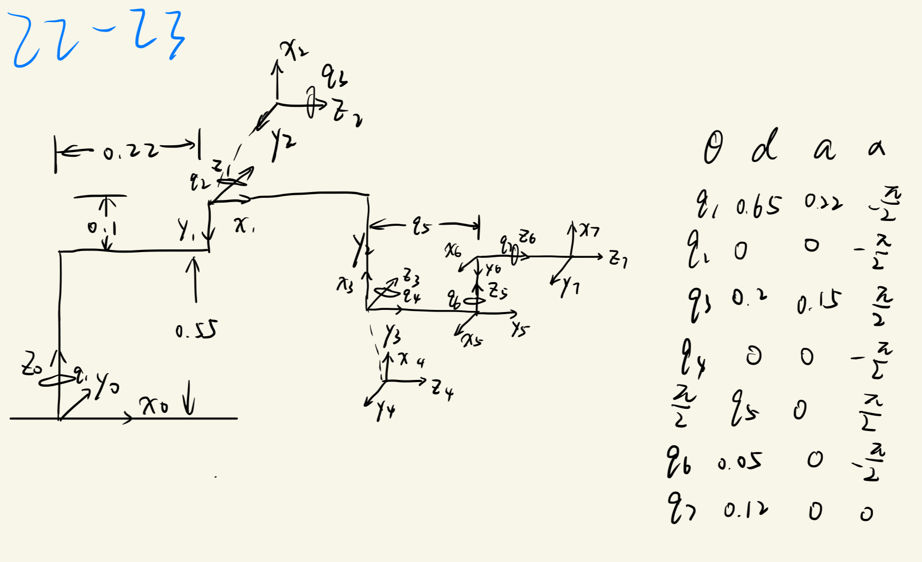
Kinematics – practise2

Slide 13
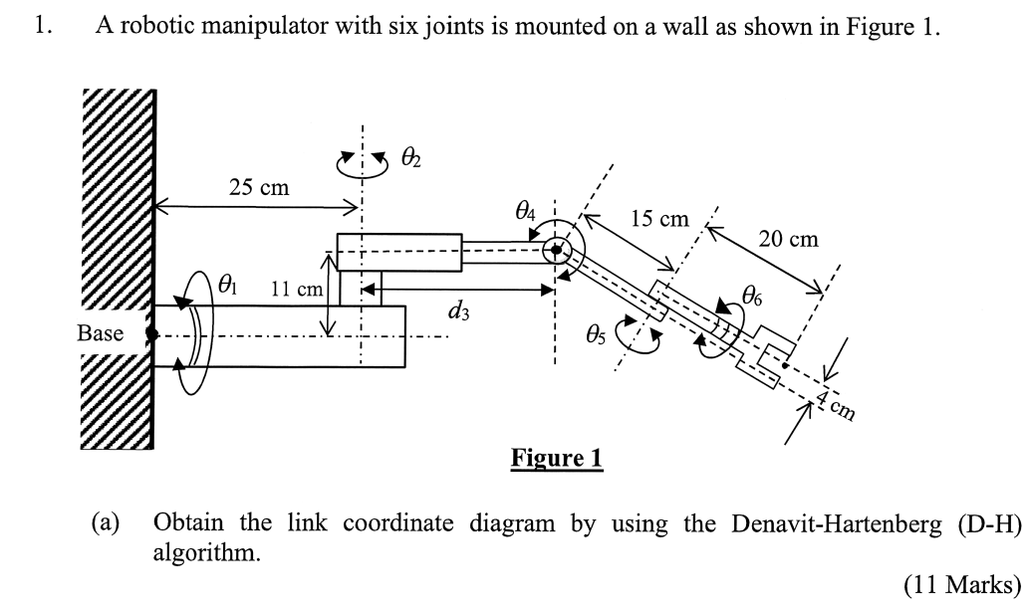
Kinematics – practise3
24-25 S2 Q1

Slide 14
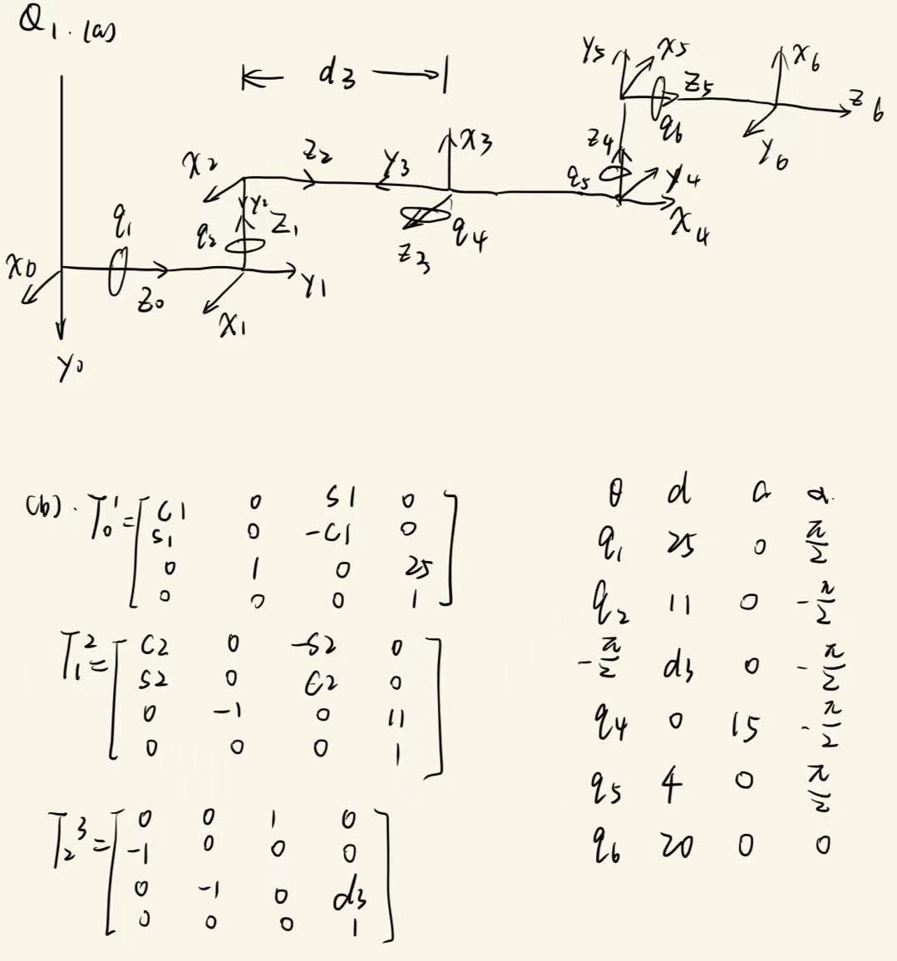
Kinematics – practise3

Slide 15
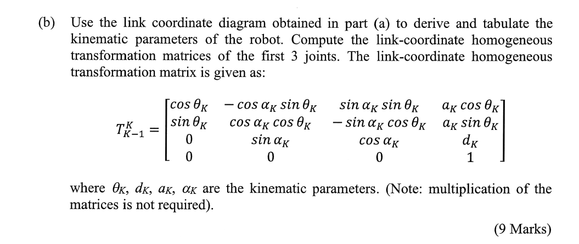
Kinematics – practise3
24-25 S2 Q1

Slide 16
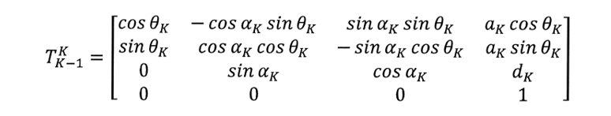
Kinematics – practise3

Slide 17
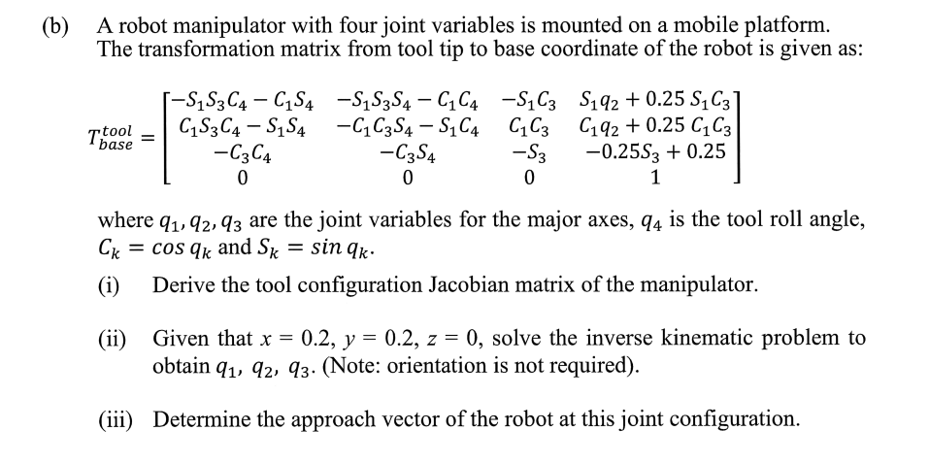
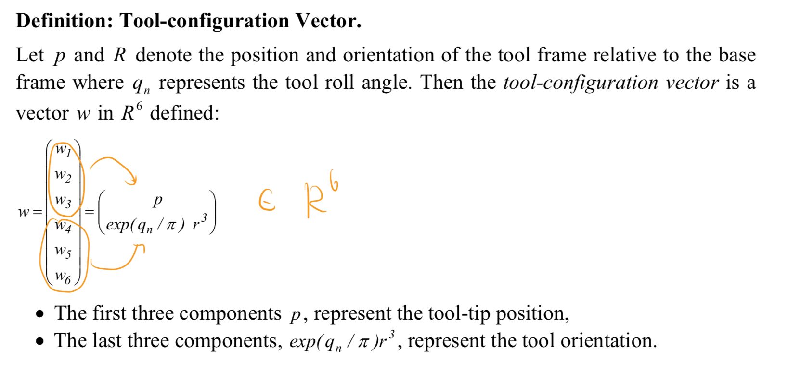
Inverse Kinematics
Problem definition:
a) tool configuration Jacobian matrix.
b) Solve kinematic problem
sometimes c) Determine the approach vector
Notes:
This problem always occur in problem3 b.
S = sin, c = cos

Slide 18
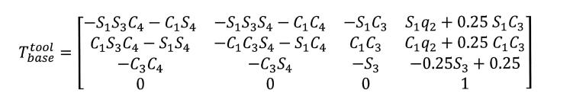
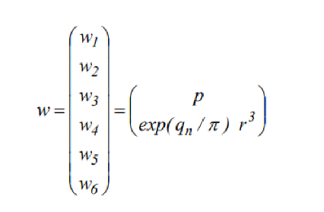
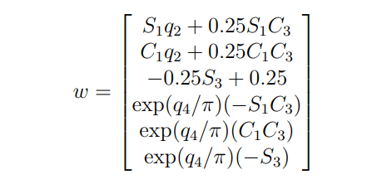
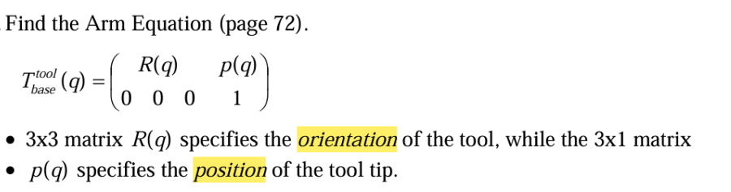
Inverse Kinematics
tool configuration matrix
Notes:
红色的是位置向量，蓝色的是旋转向量。
我们可以推导出六维向量 w。避免冗余的式子。
将给定的矩阵代入公式。
Homogeneous transformation matrices转换到tool configuration matrix的过程

Slide 19
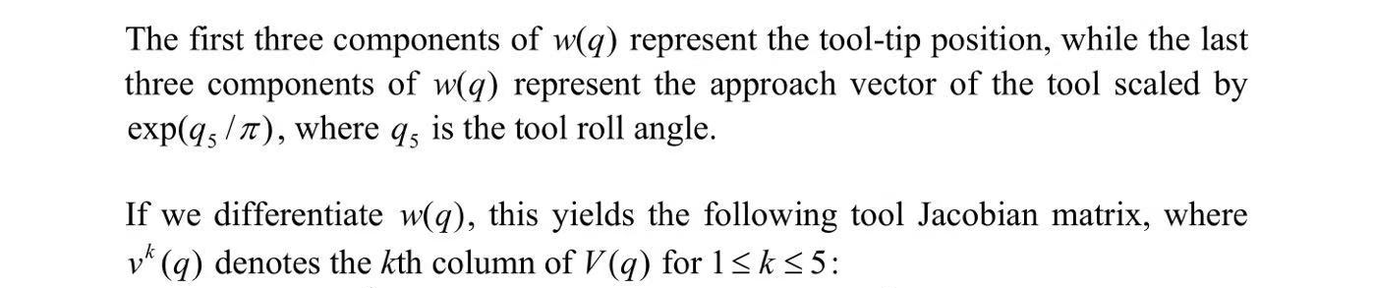
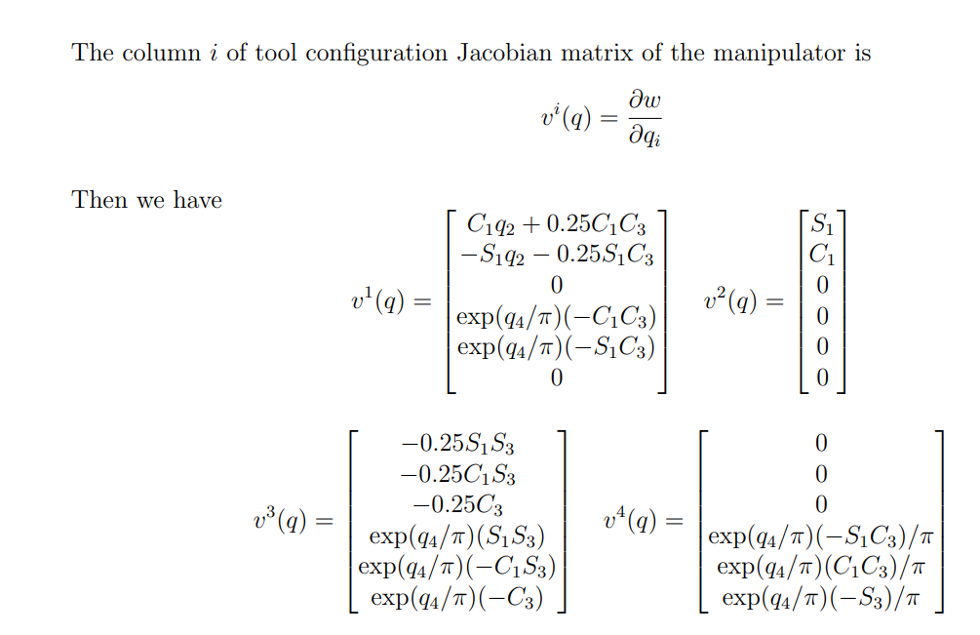
Inverse Kinematics
Notes:
If we need to solve q1-q4, we can differentiate w(q), this yields the following Jacobian matrix.

Slide 20
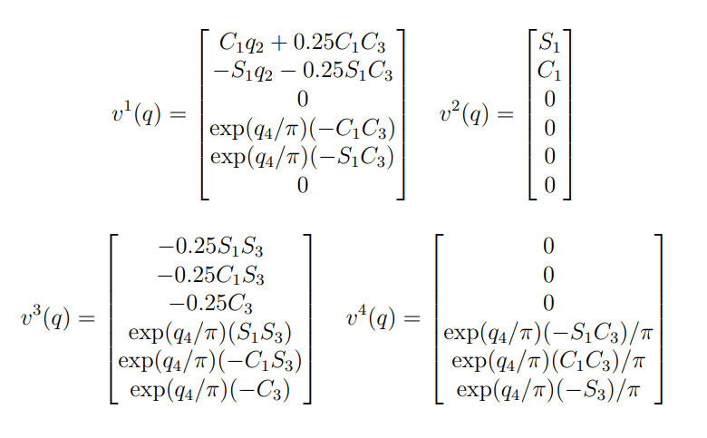
Inverse Kinematics
Notes:
Partial differentiate focus on q1, other parameters are coefficient.

Slide 21
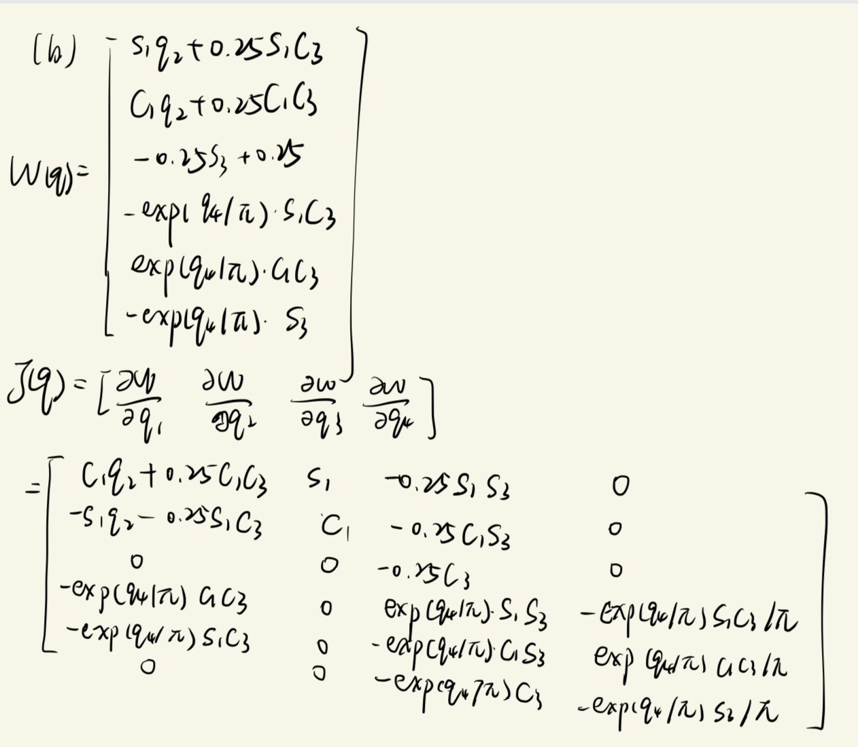

Slide 22
Inverse Kinematics

Slide 23
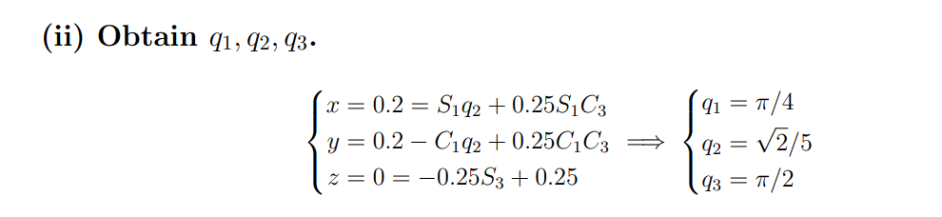
Inverse Kinematics
Notes:
The first three rows equal to your given x,y,z, represent the position of the tool
Solve the simultaneous equations.

Slide 24
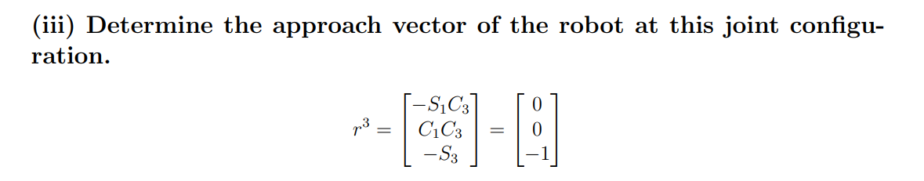
Inverse Kinematics

Slide 25
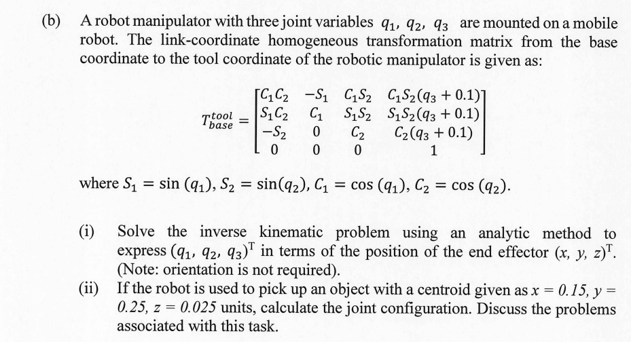
22-23 S2 Q3

Slide 26
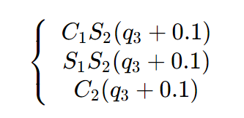
= x
= y
= z

Slide 27
2. Dynamics and Control

Slide 28
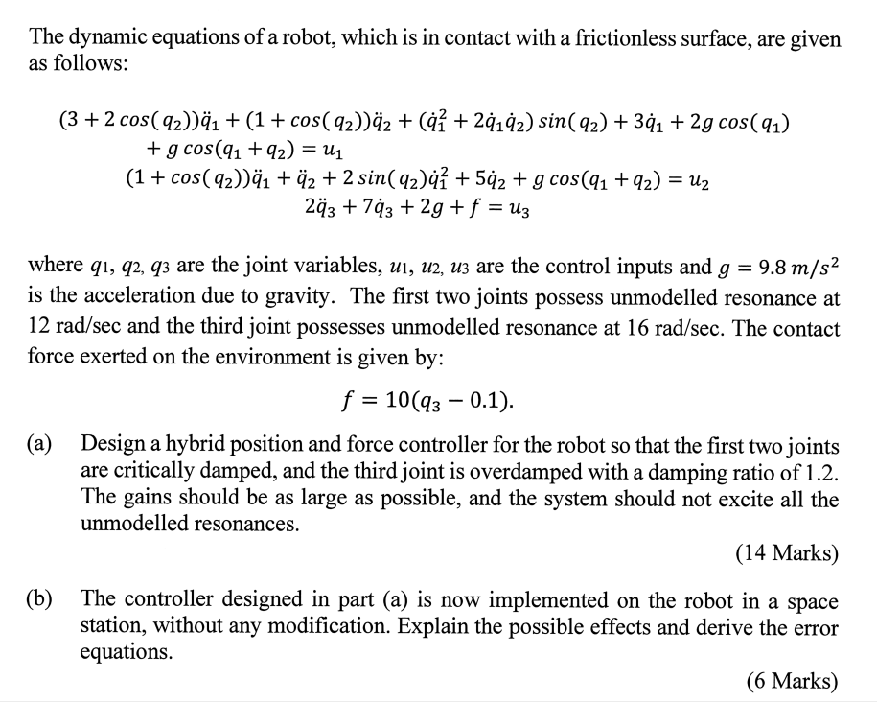
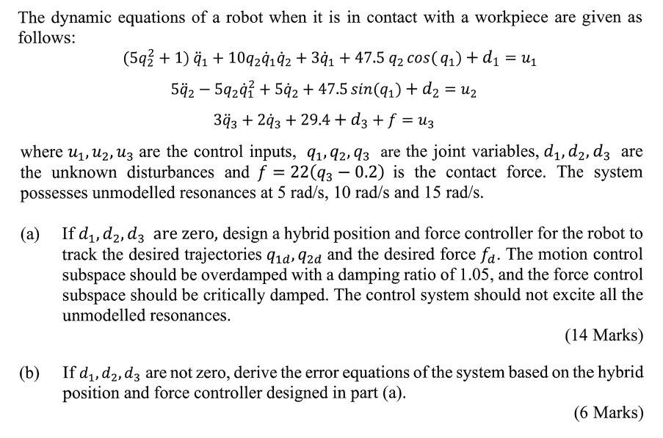
Dynamics and Control

Slide 29

Dynamic Model
For a robot with n degrees of freedom (DOF), its dynamic equations can usually be written as:
Joint Position Vector
Joint Velocity Vector
Joint Acceleration Vector
Joint Torque/Force Vector
Mass Matrix
Coriolis/Centrifugal Force Vector
Gravity Vector
Notes:
要让机器人按预定轨迹运动，必须精确计算出需要施加的输入τ

Slide 30
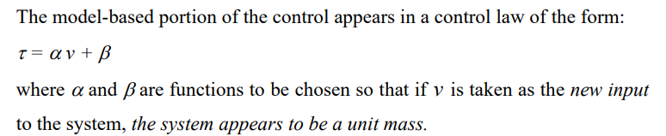


Computed Torque Control
Substituting the above control law into the dynamic equation, we get:
Notes:
第一个问题：怎么让机械臂精准、平稳地跟着预设轨迹运动；

Slide 31
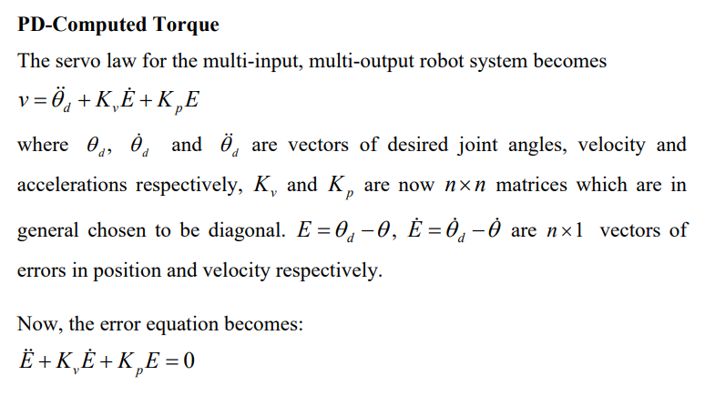
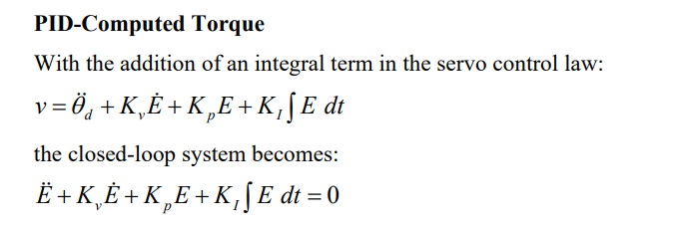



Servo Law Design
Notes:
第二个问题：怎么让机械臂的实际角度，跟上预设的期望轨迹？
核心思想: 设计新的控制输入 ，使得关节收敛到零。

Slide 32
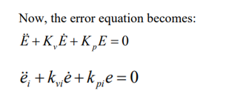



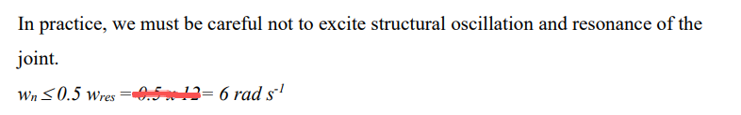
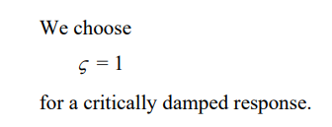
Gain Selection
Notes:
第三个问题：选择参数
只要选对Kv​和Kp​，就能让误差归零。根据期望的系统响应（如超调、响应速度）选择伺服控制器增益K
阻尼比和自然频率

Slide 33
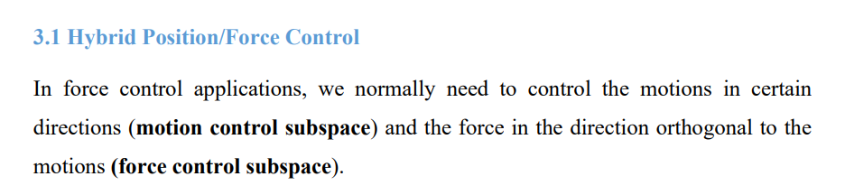
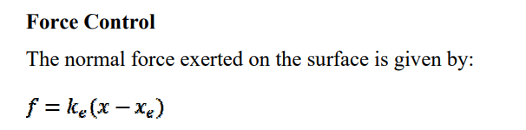

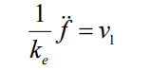
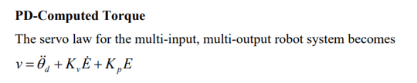
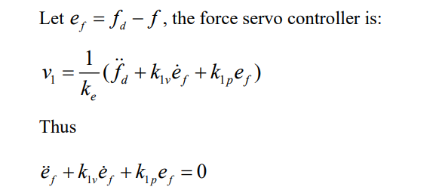
Hybrid Position/Force Control
Notes:
第四个问题：怎么让机械臂和环境接触时，既能保持运动，又能精准控制接触
当机器人与环境交互时，在某些方向控制位置 (Position)，在与之正交的方向控制力 (Force)
切向 / 位置控制方向：沿着接触面的运动方向，让它沿着预设轨迹走；
法向 / 力控制方向：垂直接触面的方向，让它用固定的力压在接触面上。

Slide 34
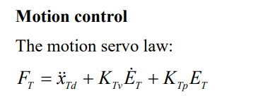
Hybrid Position/Force Control

Slide 35

summary

Slide 36

21-22 S2 Q2

Slide 37


Slide 38



Slide 39


Slide 40


Slide 41


Slide 42






Slide 43
summary

Slide 44

23-24 S2 Q2

Slide 45


Slide 46


Slide 47


Slide 48


Slide 49




Slide 50

24-25 s1 q2

Slide 51


Slide 52


Slide 53


Slide 54


Slide 55


Notes:
定义轨迹误差
其中q1d​是q1​的期望轨迹，q1​是实际轨迹。对时间求二阶导，得到误差的加速度
需要得到误差闭环动态方程，让误差收敛到0
对误差方程做拉普拉斯变换（零初始条件），得到闭环系统的特征方程：

Slide 56


Notes:
对应的特征方程为s2+2ξωn​s+ωn2​=0，其中：
ξ为阻尼比，决定系统的振荡特性
ωn​为固有频率，决定系统的响应速度，值越大响应越快

Slide 57


Slide 58


Slide 59
Thank you

